Slide 1


Who are we?
Situational Analysis
SOUR
“We combine cocktails at home with environmentally friendly packaging.”
Product doesn’t contain any alcohol, only the mixer- allows for us to sell our product anywhere.
We will be using seaweed pods sourced from Ooho, who are based out of Europe. Seaweed is an eco-friendly alternative to current products.
SOUR is a brand new, revolutionary product that addresses a massive market gap.
Source: Foresters Financial, 2019
‹#›

Slide 2
What are our strengths and weaknesses?
Situational Analysis
Internal Strengths
Internal Weaknesses
First company with completely compostable packaging
Cost-efficient business-model
The whiskey-based RTD market is fairly untapped. Whiskey Invest Direct (2020) reports that, “RTD sales volumes will have risen by 43% during 2020 and projects that it will maintain a compound annual growth rate of +21.8% up to 2024”
Cost per-unit will allow for profits to quickly be achieved with minimal sales required
Sour Pods will collaborate with ‘Ooho’, the brand which received a lot of praise for their environmentally-sustainable technology. Therefore, this will add credibility to our company’s name, promote goodwill and start healthy relationship with our target consumer.
It is a start-up business, the recognition and brand presence are nil
Heavy investments required, unsure revenue & many expenses
Extra caution is required to ensure that each batch of Sour Pods meets the North American Health and Food standards
COVID-19 will cause delays in imports of pods from England. A report from Statistics Canada (2021) states that “consumption goods saw a -12.3% decline from just January 2020 to June 2020”
COVID-19 will also affect our services as the shipping of products to customers, might experience delays
Insight: Though there are startup risks, the cost efficient business model, product differentiation, and external industry trends make this a viable business
Source: Foresters Financial, 2019
‹#›

Slide 3
Cost Components
Product Cost Breakdown
Item | Cost
1-ounce lemon juice | $0.03 (Walmart.ca)
1-ounce sugar | $0.059 (Walmart.ca)
Ooho packaging | $0.002 (Ooho.com)
Delivery (1 ounce) | $0.16
Youtube Ads | $0.15
Instagram Ads | $0.20
= $0.601
Insight: Affordable cost components make it easy to penetrate the market with a low price point
Notes:
*The table shows costs components for SOUR PODS for every 1 serving:

Slide 4
Insight: Deeper Dive
Product Costs + TAM consumers estimated sales per capita = With our product costs being under a dollar per unit, we will be able to mass produce Sour Pods at a relatively affordable price. With our TAM consumer predicted to spend $5.45 per capita on RTD whiskey based cocktails, our product will fit right onto that price range and be attractive to our target consumers. By producing an affordable product we also hope to entice trials and gain consumers from outside our traditional whiskey consumers or non-RTD consumers. We aim to use our low product costs to our advantage, and will allow us to scale effectively to our market size as it grows.

Slide 5
What is our market size?
Market Sizing
TAM
FACT: Per capita sales of spirits, Canada, 2019/20 = CA$190.1
FACT: Spirits market share of whiskey, Canada, 2019/20 = 29.9%
= CA$56.84 (-> estimated per capita sales of whiskey, Canada, 2019/20)
FACT: As of June 2016, 14% Canadian of age 18-34 years old mostly consumed mixed drinks or cocktails among all other alcoholic beverages (Statistics Canada, 2016)
FACT: In the last three years, RTD alcoholic beverages were most often consumed (light) alcoholic beverages in the U.S. And the trend shows that it is becoming more popular in the recent years, with 47% share of respondents in 2020 (Statistica, 2021)
SAM
SOM

Slide 6
What is our market size?
Market Sizing
Serviceable Addressable Market
Market size = population of Canada * estimated per capita sales
= 38 million * 2.56
= 97.2 million
18-34 years old; otherwise, they would much prefer to drink outside, e.g. at a bar or drink something better
Likes mixed drinks and cocktails
Also likes to drink whiskey
Finally, has a preference for RTD alcoholic beverage
TAM
SAM
SOM
Constraints:
Estimated per capita sales of whiskey infused mixed drinks or cocktails, Canada, 2019/20 = 56.84 * 14%
= CA$7.96
Now, estimated per capita sales of RTD whiskey drinks, Canada 2019/20 = 7.96 * 47%
= CA$3.74

Slide 7
What is our market size?
Market Sizing
TAM
SAM
FACT: Annual CPI of non-alcoholic beverages in Canada in 2020 was 130.3; 68.5% of per capita sales of spirits, Canada, 2019/20
FACT: Now we will use the ratio of CPI of non-alcoholic beverages (2020) and per capita sales of spirits to calculate the estimated per capita sales of sour pods in Canada.
Estimated per capita sales of sour pods = 3.74 * 68.5% = CA$2.56
SOM

Slide 8
What is our market size?
Market Sizing
Total Addressable Market
For our TAM consumers, we can define them without the constraint of having preference for RTD beverages. This is because RTD alcoholic beverages are a fairly new category of alcoholic beverages and its popularity is expected to increase in coming years.
Estimated per capita sales of sour pods = 7.96 * 68.5%
= CA$5.45 (more than double of SAM)
TAM
SAM
SOM

Slide 9
What is our market size?
Market Sizing
Serviceable Obtainable Market
For our SOM consumers, we can define them by adding additional constraints to our existing SAM constraints. One such could be that our consumers are mostly likely to drink sour pods at their home or some other specific settings
FACT: As of 2015, most common alcohol drinking occasions among Canadians are:
In the first rank, ‘consumed when relaxing/after work/ working around home’ which is our more specific target consumer- 27%
FACT: In the second rank, ‘while watching a game’, also our target consumer that we want to incorporate - 21%
Therefore, estimated per capita sales of sour pods = 2.56 * 48%
= CA$1.23 (more than about half of SAM)
TAM
SAM
SOM

Slide 10
What are some industry trends we can address?
Industry Analysis
FACT: Alcohol ecommerce grew by more than 40% in 2020
Opportunity to establish ourselves in a relatively new online marketplace for at home cocktails
Few competitors in this space

Slide 11


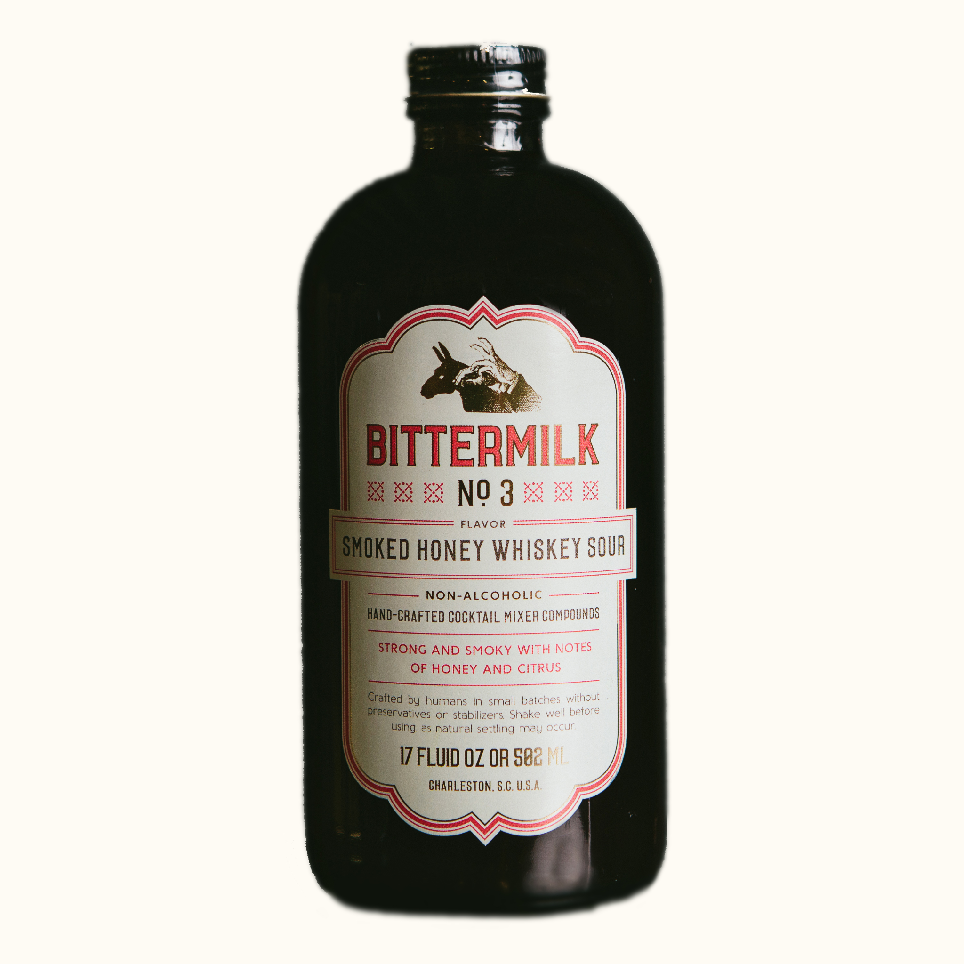

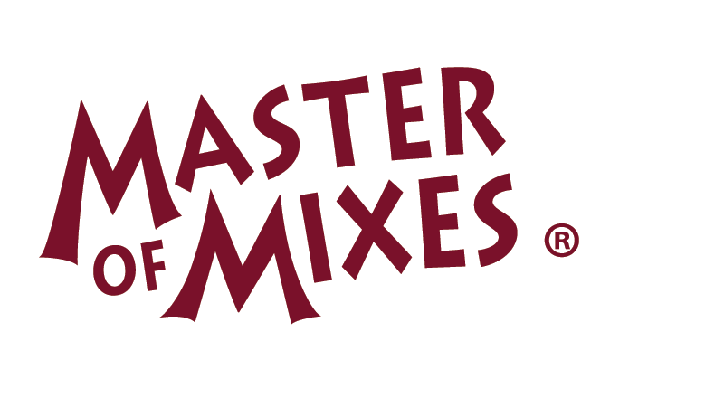
Who are our competitors?
Competitor Analysis
Selection Criteria: Comparable size, Value proposition, Mission alignment , Location
Competitor Insights
1
High
SOUR
Other whiskey sour pods require the use of a cocktail machine to serve
2
Eco-Friendliness
Competitors packaging is not eco-friendly and relies heavily on the use of plastics. This does not support social and economic trends
Low
Creating a low-price, eco-friendly sour product is a strong differentiator amongst competitors
Low
Price Point
High
‹#›

Slide 12
Case Study: Mr. and Mrs. T
Competitor Analysis
Mr & Mrs T offer a cheap low quality whiskey sour mixer that would be targeted to either first time consumers of the cocktail or those looking for a cheap mixer that resembles the taste of a whiskey sour. Their packaging is not environmentally friendly as it is sold in a plastic bottle and long term storage is questionable after the bottle is unsealed. One of the great benefits of our whiskey sour is that we use capsules (or pods) to preserve the flavour in each serving.

Slide 13
Case Study: Mr. and Mrs. T
Competitor Analysis
The Bartesian Whiskey Sour Cocktail Mix is our closest competitor since they offer a relatively high quality whiskey sour served in capsules. We believe that by sourcing our ingredients overseas we will be able to offer a high quality product and position ourselves at the top end of the market. Our pods will also be compatible with all cocktail mixers this way we can still target our competitors customers without forcing them to purchase new equipment.

Slide 14
Speculative Assumptions and Insights (CDSTEP)
Competitor Analysis
Pods are still a new concept in the alcohol industry however advancements in technology have allowed us to offer a longer lasting and better tasting whiskey sour than our by-the-bottle competitors
Shifts in social and economic trends have put an emphasis on preserving the environment and that is why part of our mission with our whiskey sour pods concept is to offer a sustainable and eco-friendly alternative to plastic bottles
By establishing ourselves as an ecommerce business, we will be able to get a solid foothold in the current market as we can cast a wider net to our target market
We also plan on capitalizing on the impact of COVID-19 by positioning ourselves as a restaurant style cocktail served at home.

Slide 15
Insight: Partnership with Ooho
Partnership with Ooho + Competitors lack of environmentally-friendly packaging = By partnering with Ooho, we have been able to make Sour Pods a completely biodegradable product, leaving no waste behind for future generations. None of our competition offer this, mainly using plastics or glass for their packaging. With the socio-economic trends shifting towards green solutions, we see this as an amazing opportunity to be a market leader. By having this distinct advantage, this is most definitely a factor we will be promoting during our marketing campaign.

Slide 16
Appendix
References
https://www.irishtimes.com/business/retail-and-services/world-s-first-facility- converting-plastic-waste-to-wax-opens-in-laois-1.3958081
https://www-statista-com.proxy.lib.sfu.ca/statistics/302372/scented-products-usage-by-user-type-in-the-uk/
https://www-statista-com.proxy.lib.sfu.ca/statistics/281296/uk-population/
https://www-statista-com.proxy.lib.sfu.ca/statistics/383733/northern-ireland-population-timeline-uk/
https://www-statista-com.proxy.lib.sfu.ca/statistics/1037176/types-of-home-scents-and-fragrances-products-most-likely-to-be-purchased-by-gender-us/
https://www-statista-com.proxy.lib.sfu.ca/statistics/1037176/types-of-home-scents-and-fragrances-products-most-likely-to-be-purchased-by-gender-us/
https://www-statista-com.proxy.lib.sfu.ca/statistics/1179697/home-scent-products-sales-by-category-us/
https://www-statista-com.proxy.lib.sfu.ca/statistics/1179693/top-manufacturers-of-scented-candles-us/
https://my-ibisworld-com.proxy.lib.sfu.ca/us/en/industry-specialized/od4260/competitive-landscape#market-share-concentration
https://my-ibisworld-com.proxy.lib.sfu.ca/us/en/industry-specialized/od4260/industry-at-a-glance
https://my-ibisworld-com.proxy.lib.sfu.ca/us/en/industry-specialized/od4260/competitive-landscape#cost-structure-benchmarks
https://www.irishtimes.com/business/retail-and-services/world-s-first-facility-converting-plastic-waste-to-wax-opens-in-laois-1.3958081
https://www-statista-com.proxy.lib.sfu.ca/statistics/1019774/plastic-waste-volume-globally/
https://www-statista-com.proxy.lib.sfu.ca/statistics/228380/people-who-pay-more- for-eco-friendly-products-and-services/

Slide 17
References
Barton, J. (2019). How Much Do Instagram Ads Cost. SEO Resellers Canada. Retrieved from https://seoresellerscanada.ca/how-much-do-instagram-ads-cost/
Barton, J. (2019). Your Guide to YouTube Ads: How Much Does YouTube Advertising Cost. SEO Resellers Canada. Retrieved from https://seoresellerscanada.ca/your-guide-to-youtube-ads-how-much-does-youtube-advertising-cost/
Ltd, M. D. (n.d.). Smoothies Market Size, Share, Trend Analysis: North America: Europe: APAC: MEA: LA. Retrieved from https://www.marketdataforecast.com/market-reports/smoothies-market
Statistics Canada. (2021). Impact of COVID-19 on merchandise imports: evidence based on end-use good. Retrieved from https://www150.statcan.gc.ca/n1/pub/13-605-x/2021001/article/00001-eng.htm
Vencat, E. (2020, October 19). Top 10 Diet Trends for 2021. Retrieved from https://youbars.com/blogs/news/top-10-diet-trends-for-2021
Walmart.com. Retrieved from https://www.walmart.com/ip/Mr-Mrs-T-Bold-Spicy-Bloody-Mary-Mix-1-75-L-bottle/36300569
Woodard, R. (2020). Scotch & RTDs: The Time is Now. Whiskey Invest Direct. Retrieved from https://www.whiskyinvestdirect.com/whisky-news/scotch-rtd-112020201

Slide 18
References
Crandall, P.G., Mauromoustakos, A., O’Bryan, C.A., Thopmson, K.C., Yiannas, F., Bridges, K., Francois, C. (2017). Impact of the Global Food Safety Initiative on Food Safety Worldwide: Statistical Analysis of a Survey of International Food Processors. Journal of Food Projection. 80(10). 1613-1622. https://doi.org/10.4315/0362-028X.JFP-16-481
Katen, E., Turner, N. (2019, March 26). New immigrants made up 61% of Canada’s population growth in 2018. CIC News. https://www.cicnews.com/2019/03/new-immigrants-made-up-61-of-canadas-population-growth-in-2018-0312086.html#gs.d0velg
Bedford, E., (2019, November 28). Domestic Beer Consumption Canada Age Group 2019. Statisa. https://www.statista.com/statistics/339801/beer-consumption-in-canada-by-gender-and-age-group/
Conaway, J. (2020, December 1). Total Alcohol Consumption in Canada. Statista. https://www.statista.com/topics/2998/alcohol-consumption-in-canada/
The Pricer. (2016, May 23.). Ohoo the edible water bottle or bubble cost. https://www.thepricer.org/ooho-the-edible-water-bottle-or-bubble-cost/

Slide 19
References
Sustaina. (2018, September 21). Rethink your drink with water capsules. Global Opportunity Explorer. https://goexplorer.org/edible-water-capsules/
Boseveld, S. (205, May 15). How we drink: Here's everything you need to know about Canadians' overall boozy habits. National Post. https://nationalpost.com/life/how-we-drink-from-how-much-to-how-often-heres-everything-you-need-to-know-about-canadians-boozy-habits
Spirits Canada. (2019, January 21). Spirits show strong growth in Canada in 2018. https://www.restobiz.ca/spirits-show-strong-growth-canada-2018/
Ready-to-Drink Cocktails are Growing Fast. (2018, July 6). The Algoma News Review. http://www.thealgomanews.ca/ready-to-drink-cocktails-are-growing-fast.
NielsonIQ. (2019, May 21). How newer ready-to-drink beverages and packages are shaking up the adult beverage market. https://nielseniq.com/global/en/insights/analysis/2019/how-ready-to-drink-beverages-and-packages-are-shaking-up-the-adult-beverage-market/

Slide 20
Appendix
Jasleen’s Individual Report:
A Preliminary Product Idea
A product called ‘Sour Pod’ which is basically a ‘Ready-to-consume’ tasting mixer that will be an alternative to the current ‘whiskey and coke’ blend and other basic sodas. This product is different than current mixers in the market because, first: we’ll use a sustainable and environment friendly te
chnology to package our product, to ensure ‘zero’ waste, second, we will provide a tasty and quality mixer that will allow you to experience excellent cocktails, from the comfort of your home.
External Facts (Consumers)
Fact 1
According to a data from Statistics Canada, Canadians spent $22.1 billion (2017). From which $5.1 billion was spent on spirits. This number has now increased to 6 billion, according to Statista, in 2020 year-end.
More market research is needed, but for now let’s assume that British Columbia is responsible for 30% of this consumption. Therefore, $1.8 to $2 billion would be the estimated market size.
Source:
https://www.statista.com/statistics/895635/frequency-of-alcohol-consumption-by-province-canada/
https://www.cbc.ca/news/business/statscan-alcohol-sales-1.4095446

Slide 21
Appendix
Fact 2
The consumption of alcohol has increased since COVID-19, in Canada. According to Canada.ca “Recent surveillance surveys suggest that while between 14% and 18% of adult Canadians have increased the amount of alcohol they consume, a similar proportion (9%–12%) have decreased their consumption; for most Canadians (70%), their drinking has remained the same.”
This will be a positive change for SourPod’s market.
Source: https://www.canada.ca/en/public-health/services/reports-publications/health-promotion-chronic-disease-prevention-canada-research-policy-practice/vol-41-no-9-2021/changes-alcohol-consumption-covid-19-pandemic-gender-differences-emotional-distress.html
External Facts (Competition)
Fact 1
According to Vancouver Sun, “Canada’s interim competition commissioner is urging B.C. to change its liquor policy to allow more competition, spark innovation and lower prices.”
Therefore, more competition is likely to enter the market and the prices due to government pressure/policies the prices are likely to fall.
Source: https://vancouversun.com/business/local-business/b-c-urged-to-change-liquor-policy-to-allow-more-competition-lowering-prices

Slide 22
Appendix
Fact 2
The modern-day Canadian consumer are becoming more conscious with their brand choices and demanding the companies to become environmentally sustainable.
Therefore, with the help of Ooho’s technology, we can cater to these needs and attract more customers.
Source: https://dailyhive.com/vancouver/emerging-consumer-trends-made-in-canada
Internal Facts (Company)
Fact 1: Cost of new product.
While striving to draw customers away from the classic whiskey mixers such as coca cola, ginger ale, and lemonade, Sour Pods will have to maintain a Competitive Pricing strategy compared to these cheaper alternatives. That being said, pricing will be a mix of Cost-Plus pricing and Competition-Based pricing initially. Once promotions and sales initially endorse trials and create a strong base of frequent consumers, price can be adapted towards a more customer value-based pricing.
Fact 2:
Team strengths: First company with completely compostable packaging while being very cost efficient, the whiskey based RTD market is fairly untapped, cost per-unit will allow for profits to quickly be achieved with minimal sales required,
weaknesses – Start-up business, lots of investments, unsure revenue and many expenses.

Slide 23
Appendix
Liz’s Individual part:
A Preliminary Product Idea:
Omni-directional VR gaming console for exercise use. This product currently exists for VR gaming purposes and e-sports purposes, however, the current company offering this product (Omni by Virtuix) is missing some factors that would make it compatible for fitness purposes.
Our differentiating factor would be the marketing and product mix.
External Facts (Consumers):
Fact 1: The ideal customer segment for this product is male consumers aged 20-34.
Assumption: 2019 data is still accurate
Assumption: The US market is the same as the Canadian market

Slide 24
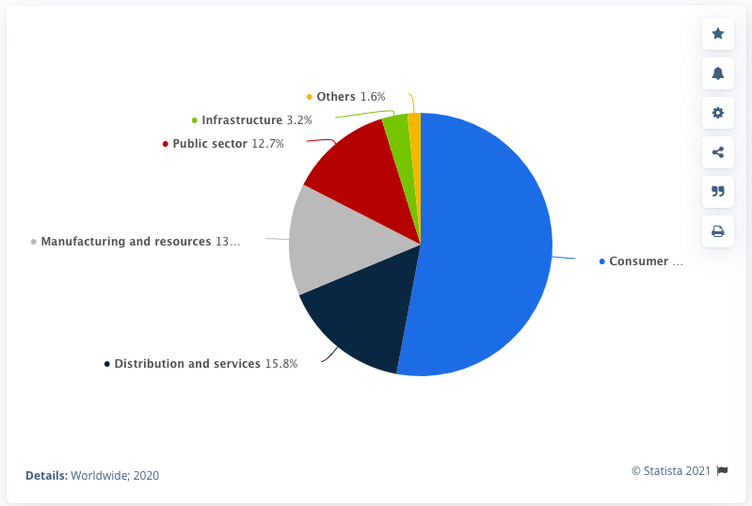
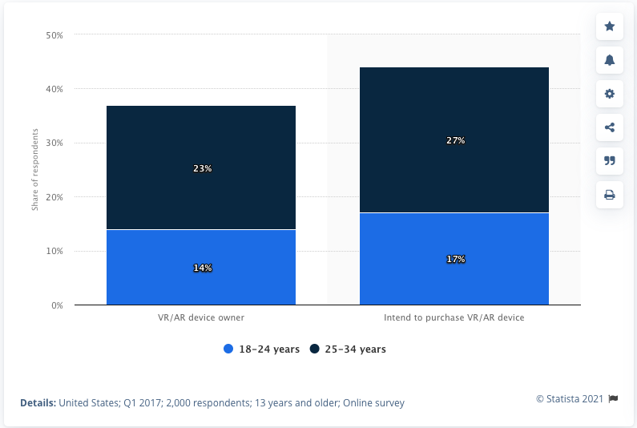
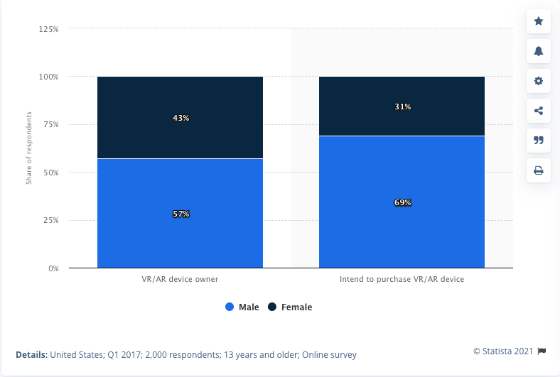
Appendix
The consumer segment owns 53% of the VR market today
Source: https://www.statista.com/statistics/737587/ar-vr-spending-share-worldwide-by-segment/
Approximately 100% of consumers that either intend to purchase VR/AR or own VR/AR systems in the US are between the ages of 18-34 year old.
Source: https://www.statista.com/statistics/740760/vr-ar-ownership-usa-age/
The vast majority of those who either intend to purchase VR/AR systems or own VR/AR systems in the US are male.

Slide 25
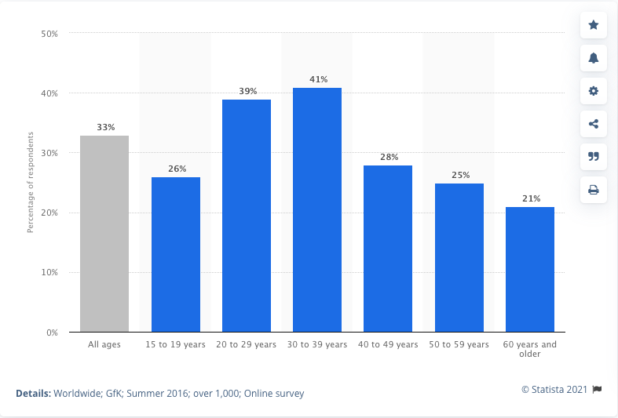
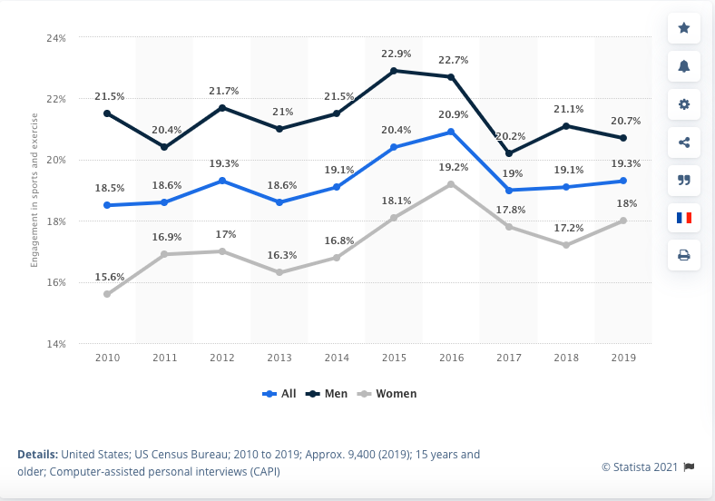
Appendix
Source: https://www.statista.com/statistics/740747/vr-ar-ownership-usa-gender/
80% of those who use fitness tech devices are between the ages of 20-39 years old
Source:https://www.statista.com/statistics/742448/global-fitness-tracking-and-technology-by-age/
More men than women engage in physical activity per day in the US market.
Source: https://www.statista.com/statistics/189562/daily-engagement-of-the-us-poppulation-in-sports-and-exercise/

Slide 26
Appendix
Fact 2: Consumers in the gaming sector are in need of a tool to fight the negative effects of gaming
An excessive amount of gaming causes negative physical and mental impacts:
“Various studies show that playing too many computer games causes physical damage and increases anxiety and depression in players. Many studies show that most adolescents who are addicted to computer games have high heart beat and blood pressure due to too much excitement and stress.”
Source: https://www.ncbi.nlm.nih.gov/pmc/articles/PMC3905489/
An excessive amount of sedentary gaming is a problem- the WHO recognizes gaming disorder as a disease:
“Gaming disorder is defined as “a pattern of gaming behavior (“digital-gaming” or “video gaming”) characterized by impaired control over gaming, increasing priority given to gaming over other activities to the extent that gaming takes precedence over other interests and daily activities, and continuation or escalation of gaming despite the occurrence of negative consequences.”
Source: https://www.who.int/news-room/q-a-detail/addictive-behaviours-gaming-disorder
Fitness is proven to combat high blood pressure, depression, and anxiety (all of which are impacts of excessive gaming):
“Exercising starts a biological cascade of events that results in many health benefits, such as protecting against heart disease and diabetes, improving sleep, and lowering blood pressure.”
“Exercise is an all-natural treatment to fight depression”
Source: https://www.health.harvard.edu/mind-and-mood/exercise-is-an-all-natural-treatment-to-fight-depression

Slide 27
Appendix
Fact 3: The market size estimate based on the total number of potential customers
and spending per customer is $425,818,800
Methodology for potential customers:
In order to find the total number of potential customers, I first found the total number of people who owned Wii Fit in 2013 (a fitness technology game), and the total number of people who own VR gaming technology in Canada. Considering Wii Fit is an old technology, I divided the number of people by the total population of Canada at the time, and then used that percentage to calculate a new number for the year 2021. Afterwards, I selected the smaller number of the two to find the total number of potential customers.
Key assumption: The percentage of the population interest in VR fitness technology is similar to that of the Wii Fit.
Key assumption: Those interested in VR technology would be interested in VR fitness technology.
Key assumption: Those that have it only buy one Wii Fit per person
Key assumption: An even amount of Wii fit systems were purchased annually.
Methodology for potential spending per customer:
To find the total estimated potential spending per customer, I took the total amount that Canadians spent on VR technology and divided it by the # of customers. For Wii Fit, I used the cost of the system and accounted for inflation.
Afterwards, these numbers were multiplied together to get the market size estimate.
Supporting research:
“Today's prices are 1.12 times higher than average prices since 2013, according to Statistics Canada consumer price index.”
Source: https://www150.statcan.gc.ca/t1/tbl1/en/tv.action?pid=1810000411

Slide 28
Appendix
Wii Fit lifelong Canadian sales are 813,000 units / 7 years = approximately 116,143 units in the year 2013 = 116,143 people owning Wii Fit systems in 2013
https://purenintendo.com/npd-reports-nintendo%E2%80%99s-wii-tops-canadian-sales-charts-wii-becomes-best-selling-next-gen-system/
Total population of Canada in 2021: 38.01 million
Source: http://datatopics.worldbank.org/world-development-indicators
Total population of Canada in 2013: 35.08 million
Source: http://datatopics.worldbank.org/world-development-indicators
In 2022, the Canadian augmented and virtual reality market is expected to reach a market size of 8 billion U.S. dollars.
Source: https://www.statista.com/statistics/866903/canada-augmented-virtual-reality-market-size/
3.3 million Canadians own VR technology in 2018
Source:
http://pulseonvr.ca/wp-content/uploads/2018/07/Situation-Analysis-Q1-2018_FINAL_ENG.pdf
Note: This doesn’t look super reliable, however, no better quality data was found. Additionally it is 2018 data.
The cost of the wii fit system is $107.53
Source: https://www.torontoprices.ca/Product/Gaming/Nintendo%20Wii/Consoles/NINTENDO-WII-FIT-PLUS-W-BALANCE-BOARD-id%3Defd72e08-68ef-4834-8ba2-76dca0a80b4d

Slide 29
Appendix
Potential customers calculation:
116,143 / 35,008,000 = 0.3318%
0.3318 * 38,001,000 = approximately 12,607,261.60 people would own Wii Fit systems in 2021.
3.3 million Canadians own VR technology
Since 3.3 million is smaller than 12.6 million, we assume 3.3 million is more accurate.
Potential spending per customer calculation:
VR: 8 billion / 3.3 million = $2424.24242424 per customer
Wii Fit: $107.53 * 1.2 = $129.036 per customer
Since the Wii Fit system is less, we will use that number.
3.3 million * 129.036 = $425,818,800 total market size
External Facts:
Fact 1: Competitor analysis
Potential competitor:
Virtuix utilizes the same technology, but simply uses it for e-sports and gaming. Their target market is completely different, however, I still consider them an indirect competitor as they are the only other company that uses this technology.
Source: https://www.virtuix.com/case-studies/

Slide 30
Appendix
Fact 2: The VR gaming industry is projected to more than double in size by 2024, alongside the global VR market size.
The Global VR market size is projected to increase from less than five billion U.S. dollars in 2021 to more than 12 billion U.S. dollars by 2024.
Source: https://www.statista.com/statistics/1221522/virtual-reality-market-size-worldwide/
Global revenue within the VR gaming industry is forecast to grow from 0.4 billion U.S. dollars in 2017 to 2.4 billion U.S. dollars by 2024.
Source: https://www.statista.com/statistics/499714/global-virtual-reality-gaming-sales-revenue/
Fact 3: The market size of the fitness industry is projected to continue to grow into 2027
There’s been a 1.9% fitness industry market size growth annually from 2006-2021
Source: https://www.ibisworld.com/canada/market-size/gym-health-fitness-clubs/

Slide 31
Appendix
Internal Facts (Company)
Fact 1: Cost of new product
Potential costs:
Approximately the cost of manufacturing a treadmill (and treadmill components) - $150-$180
Source: https://www.alibaba.com/product-detail/Treadmill-Treadmill-Manufacturer-Professional-Home-Used_60550380441.html?spm=a2700.galleryofferlist.topad_creative.d_title.660b3137wGQ8J5
Approximately the cost of manufacturing a VR headset (and VR headset components) - $50 for higher quality
Source: https://www.alibaba.com/product-detail/Vr-Headset-KIWI-Design-VR-Headset_1600301541758.html?spm=a2700.galleryofferlist.normal_offer.d_title.58dbfb15lopYK9&s=p
Fact 2:
Team strength:
We get along and has similar experiences, therefore, we are a cohesive group and have a great time with whatever we do
Team weakness:
We think and get along the same, as well as have similar experiences, therefore, team groupthink is eminent.
https://wp.nyu.edu/steinhardt-appsych_opus/groupthink/

Slide 32
Appendix
Spencer’s Individual Part
MACRO ENVIRONMENT ASSESSMENT
Economic Forces Canada’s economic situation is projected to improve slightly in 2020 due to the real estate market, residential investment and household consumption however other factors which impacted the slowdown in 2019, remain. These conditions should turn into a growth rate of approximately 1.7% for the Canadian economy in 2020. The actual GDP outlook for 2020 is 1.8 percent and 1.9 percent in 2021, which is somewhat higher from 2019’s 1.7% gain. An average growth of 1.7 percent in GDP has been projected from 2020 to 2040. As the Canadian Economy is forecasted to Grow in the coming 20 years, it is going to be beneficial for Sour Pods. Any increase of pricing over time shouldn’t affect consumer attitudes very much .
Political Forces
Some of the Political aspects affecting the food industry include the surging number of international trade contracts, the level of administrational intrusions, the degraded level of laws regarding trade protection and explicit food regulations, and future impact of growing environmental status and resulting regulations. As every coin has two sides, there are both pros and cons of the regulatory system. The agreements may lead to increased harmonization of regulations associated with food, like what has happened to the Global Food Safety Initiative (GFSI). On the other hand, there are also possibilities that the demand for global traceability of products and their attributes may increase which can be beneficial.

Slide 33
Appendix
Demographic Forces
Around the year 2018, the population of Canada increased by half of a million or approximately 528,421 number of people. The temporary residents and new international immigrants accounted for a total of 425,245 in Canada accounting for 80.5% of their growth. This inclination will help our product to reach out to masses and will ultimately raise the sales of Sour Pods. Moreover, almost 39% of all drinks in 2019 was consumed by Canadian aged between 18 and 35 whereas individuals between 35 and 49 hold the second biggest consumer group. Additionally, almost $246 is spent annually per person on whiskey in British Columbia. This indicates the apparent increase in the demand of drinks in the upcoming future which ultimately will help Sour Pods in sales.
Natural Forces
The eco-friendly packaging will protect the beverage, making it durable, hygienic, biodegradable as well as cheap. Using inexpensive ingredients such as simple syrup, lime juice, egg white and water provides Sour Pods an advantage in both production and distribution costs, allowing widespread awareness through mass production.
Technological Forces
With growing concern toward Earth's increasingly high levels of pollution and greenhouse gasses, the London based start-up Skipping Rocks Lab has created a highly innovative solution. Using seaweed, they have created the “Ooho!”, a single serving packaging for liquids that has zero net waste, as they can be eaten or will biodegrade in four to six weeks if the casing is discarded⁸. Sour Pods has partnered with Skipping Rocks Lab to adjust the packaging size to a standard cocktail serving and change the contents to simple syrup, lime juice, water and a dash of egg white. This will produce the first single serving cocktail mix with zero net waste, with the hope that more companies adopt this approach and take steps to save the planet through efficient eco-friendly packaging.

Slide 34
Appendix
Cultural Forces
Looking to adapt to the growing global and local trends of environmental awareness becoming a top priority, Sour Pods is looking to line its company vision and goals to match these changes. College culture in the Greater Vancouver area has a very strong presence with 10+ institutions within a 75km radius. With over 70% of drinking done at either one's own house or someone else’s, giving consumers the ability to conveniently enjoy a restaurant quality cocktail at home while being much more environmentally responsible compared to plastic or metal cans used currently is the key focus of Sour Pods
SWOT ANALYSIS
Strengths First company with completely compostable packaging while being very cost efficient, the whiskey-based RTD marketing is fairly untapped.
Weakness Startup, cost of shipping pods from England, guaranteeing quality in each batch.
Opportunities Untapped market of whiskey RTD, RTD fastest growing liquor sector, very diverse in both packaging and cocktail, can sell both at private liquor stores and grocery stores since no liquor added, as much as health is focus for some people environment is universal.
Threats Popularity of NUDES will make marketing breakthrough tough, plus cannot market 0 calories, while power of supplier is very high so much have strong relationship.

Slide 35
Appendix
TARGET MARKET
Our Target consumer is Lucas, he is a 24 year old
Demographic -enjoys socializing with friends, sick of standard whiskey and coke mix every night and wants a quality cocktail to enjoy with ease.
Behavior – Enjoys drink at home after long day at work, while winding down reviewing school material, weekend warrior.
Psychographic – Happy hour lifestyle, wants to be above a whiskey and coke, something classier to improve image to his friends
Geographic • Is a born and raised vancouverite, loves city life and what all the restaurants in the area have to offer
SHORT TERM BUSINESS OBJECTIVES Market Penetration, minimal profits, establish base following of loyal customers (track behavior), receive over 200,00 views of company website

Slide 36
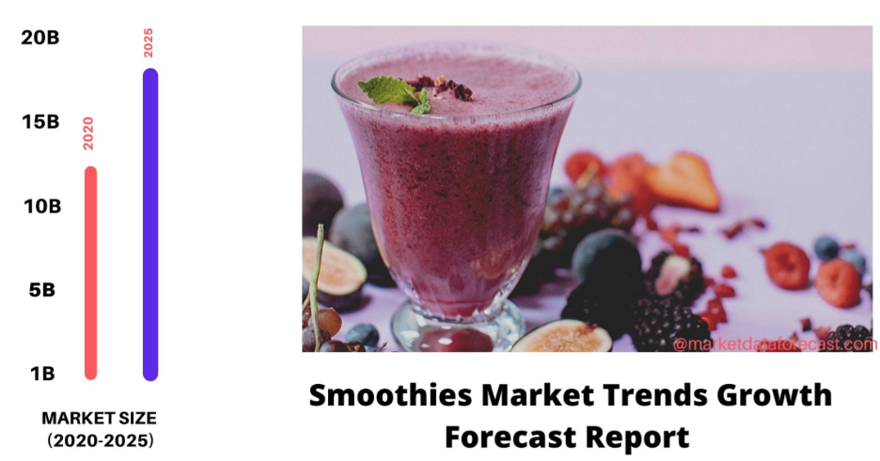
Appendix - Paul Individual Part
​​Product Idea: Healthy Dessert Smoothies
These healthy dessert smoothies are pre-packaged and will ship straight to the customer. 3 of the initial flavours will be Blueberry pie, banana split, and chocolate mousse. The ingredient structure will focus on using ingredients high in antioxidants and vitamins with no added sugars.
External facts (consumers)
Fact 1: The smoothie market size in 2019 was worth USD 12.10 Billion. This figure does not consider market segments within the smoothie market as to not limit marketing strategy alternatives.
Source: https://www.marketdataforecast.com/market-reports/smoothies-market

Slide 37
Appendix
Fact 2: The Covid-19 pandemic has certainly put health at the forefront people’s minds worldwide. Our smoothies will be high in antioxidants and vitamins which will support the trending “immune system support diet” (eating to combat covid). Marketing strategies can be used to target people who are either following this diet or are interested in boosting their immune system due to the widespread covid-19 virus.
Source: https://youbars.com/blogs/news/top-10-diet-trends-for-2021
External facts (competition)
Fact 1: Two of our closely related competitors include Daily Harvest and Smoothie Box. Both businesses offer premium, shipped to your door smoothies however, the flavour options are more targeted to those who enjoy fruit smoothies without a direct focus on dessert smoothies. Both of our competitors also only offer ready-to-blend smoothies. As a result, one of the ways we are differentiating our product is by offering a ready out of the package smoothie which saves the consumer time and money if they do not already have a blender.
Source: https://www.daily-harvest.com/browse/smoothies/carrot-cinnamon, https://www.smoothiebox.com/

Slide 38
Appendix
Fact 2: In terms of the CDSTEP trends, we are hoping to ride the health and wellness social trend as we will offer a health beneficial alternative for dessert lovers. The effects of covid 19 have emphasized the importance of maintaining good health which plays into our health and wellness value proposition.
Source: https://www.forbes.com/sites/phillempert/2020/10/19/food-trends-2021-staying-healthy-in-a-post-covid-19-world/?sh=2e183753485b
Internal facts (company)
Fact 1: Cost structure (cost is calculated on a per unit basis)
o Smoothie cost: $1.92
o Packaging: $0.10
o Fulfilment: $0.25
Total Cost = $2.27
Source: https://www.mvorganizing.org/how-much-do-smoothies-cost-to-make/
Fact 2: Team strengths – Our team has a good foundation of marketing strategies and practices. Our backgrounds range from finance/accounting to marketing with added experience in ecommerce. These skills will be especially important for our business as we will rely mostly on aggressive marketing strategies to drive sales in the first year.

Slide 39
Appendix
Fact 3: Product strengths – The manufacturing of the smoothie is likely to take place either locally or within North America which will allows us to monitor production closely and ensure production standards are met. Packaging supplies will likely be sourced from a Chinese manufacturer on Alibaba. This will allow us to save on packaging costs and as a result, lower our total landed cost.
Fact 4: Product weakness – Since we are using premium ingredients, we will be sourcing some of our ingredients from overseas. This will increase the cost of our product as we will be paying a premium to ship these inputs overseas to our manufacturing facility in North America.

Slide 40
Appendix
Asif’s Individual Part:
A Preliminary Product Idea
Eco-friendly scented-wax candles, made from 100% plastic waste.
External Facts (Consumers)
Fact 1:
Market Size = number of potential customers * spending per customer
= 8 million * CA$18
= 144 million
(See the Fact 2-6 for the explanation of the numbers used for calculation.)

Slide 41
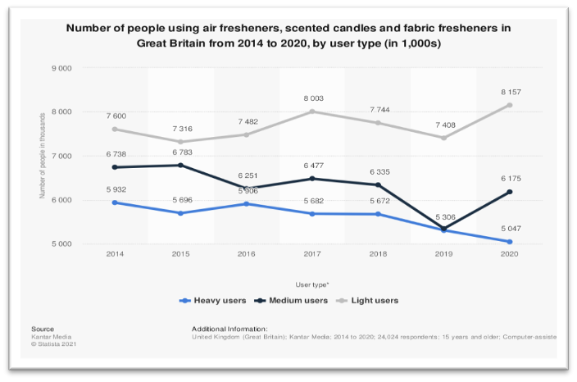
Appendix
Fact 2:
In 2020, the total number of people using air fresheners, scented candles, and fabric fresheners was 19.4 million based on light, medium, and heavy users in the Great Britain.

Slide 42
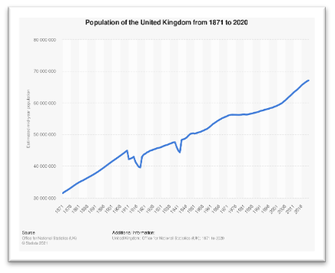
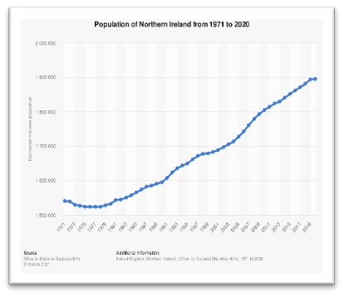
Appendix
Fact 3:
And the population of Great Britain (UK – Norther Ireland) in 2020 was 65 million. Therefore, roughly 30% of the people in Great Britain uses all 3 categories of products.

Slide 43
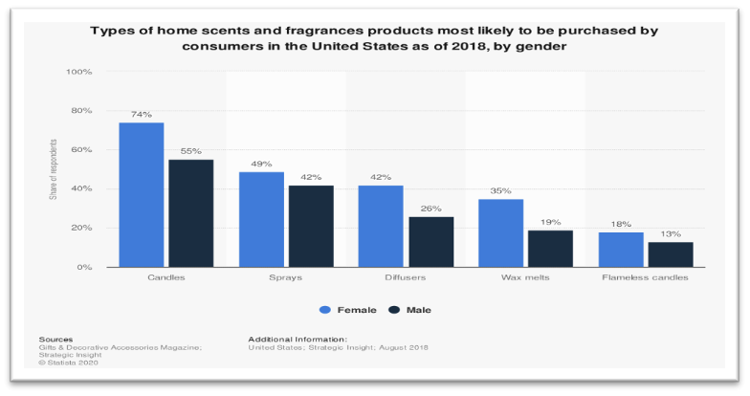
Appendix
Fact 4:
A study conducted in the US in 2018 shows that the consumer behaviour of home fragrances is more biased towards candles. About 74% females and 55% males were more likely to prefer scented candles as home scent/fragrance.
So, we will use 30% of total population in Canada for our further calculations.

Slide 44
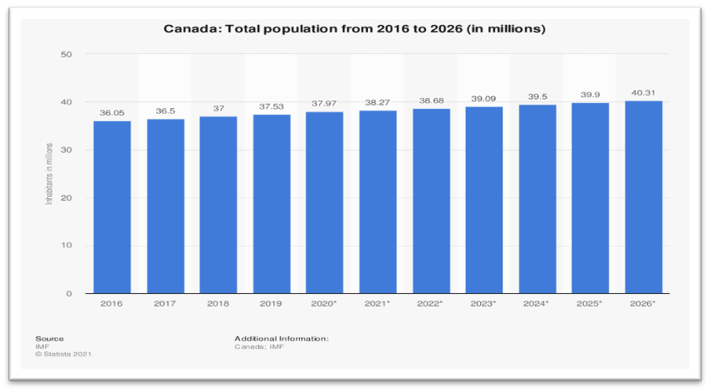
Appendix
Fact 5:
The population of Canada in 2020 was 38 million, however, the general trends show the population will increase in the coming years. Thus, 30% of 38 million is 11.4 million. Let, consider 7-8 million people (decreasing) uses scented candle in Canada, and that is our estimated number of potential customers/consumers.

Slide 45
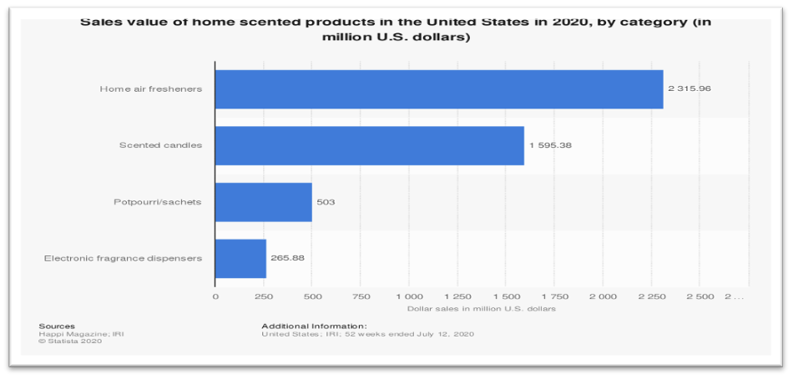
Appendix
Fact 6:
The sales value of home scented candles in the US in 2020 is 1,595.30 million dollars. Therefore, again if we consider 30% of the total population in 2020, we end up with 100 million people (increasing) that used scented candles in the US. Therefore, the spending per customer on scented candles can be estimated to be US$15-16 or CA$18-19.

Slide 46
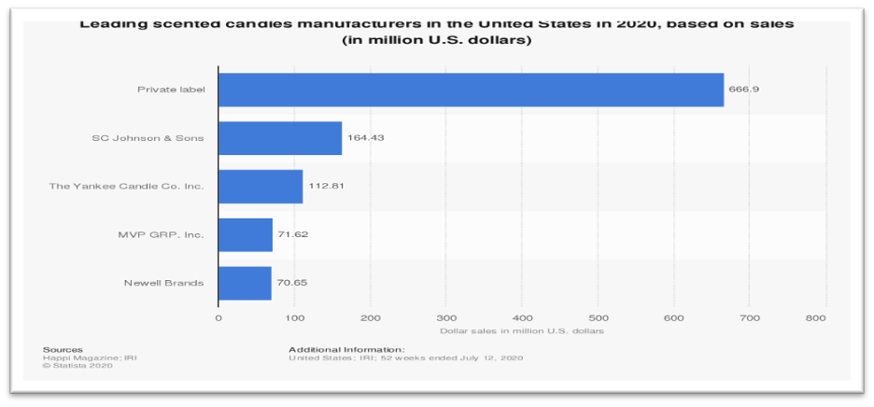
Appendix
External Facts (Competition)
Fact 1:
In a study conducted in the US in 2020 reflects that the leading scents candles companies are mostly privately owned, and the sales revenue of the private labels is 4 times higher than the second in rank, SC Johnson & Sons. This suggests that our company will be competing with small scale private companies rather than large-scale manufactures. Therefore, this structure should help us to market our product without having to compromise on the price and to get a hold on the market faster by supplying quality products.

Slide 47
Appendix
Internal Facts (Company)
Fact 1: Cost-
Based on research in the US, the cost structure of producing candles is as follows:
This research claims that in 2020 the profit margin of candles industry was 11.5% of the revenue, however, in the next 5 years, the profit margin is anticipated to increase up to more than 15% due to the reducing costs of “purchases” (COGs). As we are a start-up and as we will be using eco-friendly wax, therefore, the chances of the increase in the profit are uncertain. However, the revenue is also anticipated to gain an annual growth of 2.9% from 2020-2025.

Slide 48
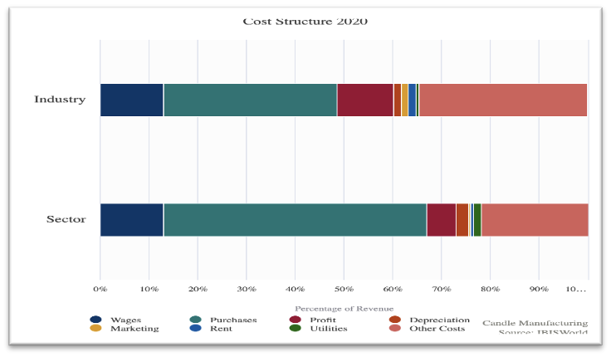
Appendix
Nonetheless, for the cost calculation we are considering that our company’s profit margin will 15% of the revenue for the next five years. Therefore, if we initially invest CA$100,000, we are expecting to earn a minimum revenue of CA$180,000 at the end of first fiscal year. A successful marketing of the product can result in an estimated compound profit of CA$260,000 after five years.
In conclusion, in five years the sales revenue will return 3.5x (three and half times) the initial amount of the investment made on the company.

Slide 49
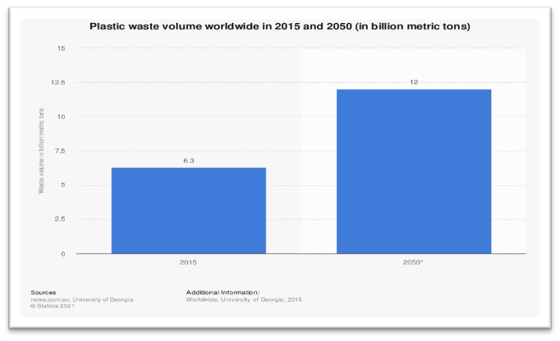
Appendix
Fact 2: Team strengths + weaknesses-
· Our product, scented-wax candles, is completely made from 100% waste plastic. Source:
https://www.irishtimes.com/business/retail-and-services/world-s-first-facility-converting-plastic-waste-to-wax-opens-in-laois-1.3958081
· And in recent years, plastic waste is a major cause of environmental pollution, and it is predicted to reach as high as 12 billion metric tons by 2050, that is double the amount of plastic waste production in 2015.

Slide 50
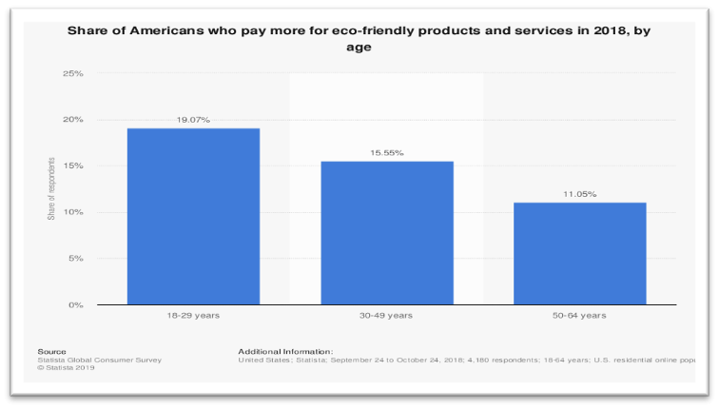
Appendix
· As peoples are being more sensible, they are moving and spending more towards eco-friendly products, and our product should be of interest to them. Moreover, this transition of people’s preference to eco-friendly products benefits the environment we live in. To support my statement, I will share a survey conducted in the US in 2018, this survey suggests that more than 15% of people of age 18-49 years are willing to pay/pays more for eco-friendly products and services, and that must have gone up by now in terms of the change in the social trends. And this is our step and contribution towards reducing plastic waste from the lands and the seas of our planet.

Slide 51
Appendix
+
· As Trifol is the only company producing wax from 100% plastic waste so we might face difficulties with the supply of eco-friendly wax from time to time.
· On the other hand, Trifol is based on Ireland and started their business very recently, therefore, getting a shipment contract, and then transporting them and maintaining the production budget might be a little difficult and tight.

